Slide 1


Arc scan
wind measurements
for power curve tests
Peter Clive
PCWG 2016-05-20

Slide 2
Contents
What is an arc scan?
Calibration
Shear sensitivity
Pointing accuracy
Track record
Extended applications
Conclusions

Slide 3

Lidar methods
There is a wide variety of lidar methods
Multiple beams
Simple scan geometry
Complex scan geometry
Variable azimuth
Variable elevation

Slide 4
Arc scans
Arc scans – or “sector scans” – have been used for decades to make lidar measurements in locations a horizontal distance from the device, e.g.
Schwiesow, R.L., Köpp, F., and Werner, Ch., Comparison of CW-Lidar-Measured Wind Values Obtained by Full Conical Scan, Conical Sector Scan and Two-Point Techniques, Journal of Atmospheric and Oceanic Technology, Vol. 2, No. 1, 1985
Clive, P.J.M.
Getting it right pre-construction, EWEA, 2011
2nd generation lidar techniques, EWEA, 2010
Etc.

Slide 5
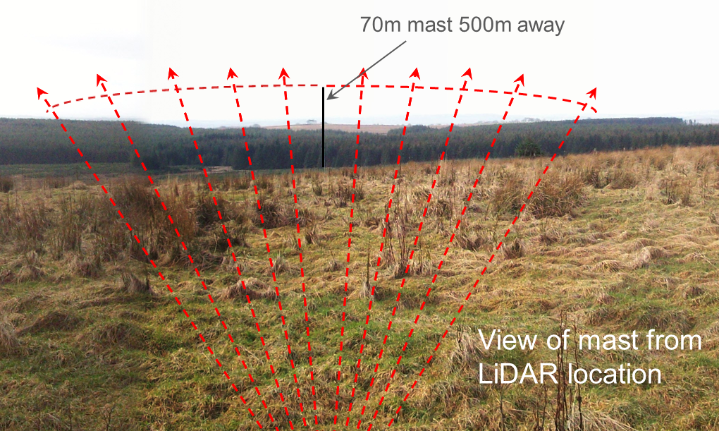
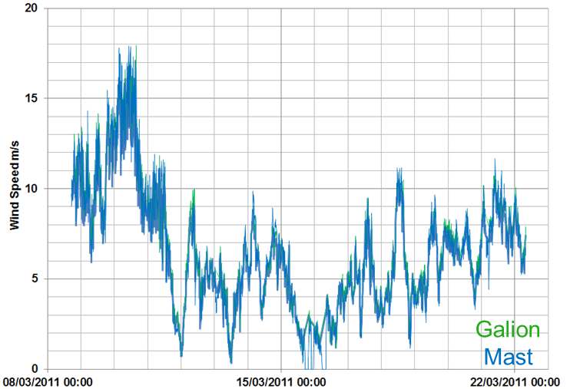
Arc scans
Example onshore arc scan verification from 2011 at Whitelee, south of Glasgow
Normal acceptance criteria wrt. OLS linear regression R² and Slope fulfilled
Clive, P.J.M., Unlocking the value of lidar, EWEA 2012

Slide 6
From Doppler shift to wind speed
Line of sight data are acquired by Doppler Lidars. This gives the radial component of the wind velocity vector …
z
U = (u,v,w)
φ
LoS
e_{LoS} = (e₁,e₂,e₃) = (sinθ cosφ, cosθ cosφ, sinφ)
θ
y
v_{LoS} = U.e_{LoS} = ue₁ + ve₂ + we₃
v_{LoS} = u sinθ cosφ + v cosθ cosφ + w sinφ
w
u
v
x

Slide 7
From Doppler shift to wind speed
Wind speeds can also be derived by observing the functional dependence of the radial velocity on beam orientation relative to the wind direction …
z
φ
LoS
θ
y
w
u
v
x

Slide 8
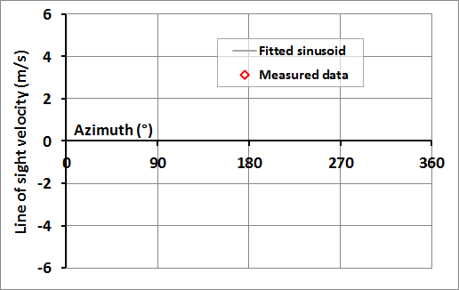
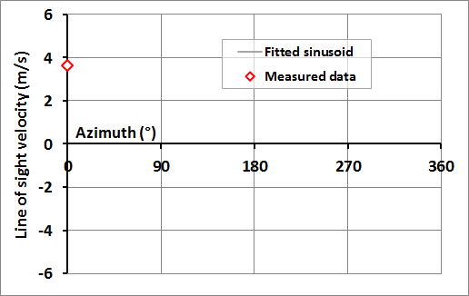
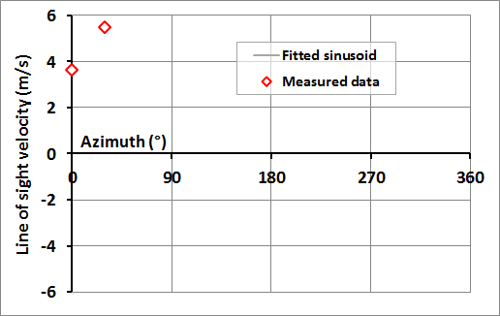
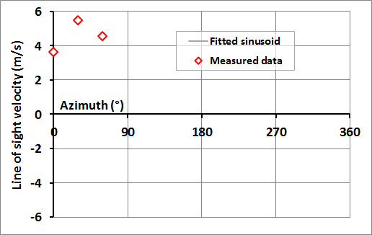
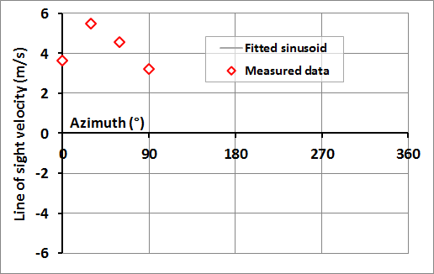
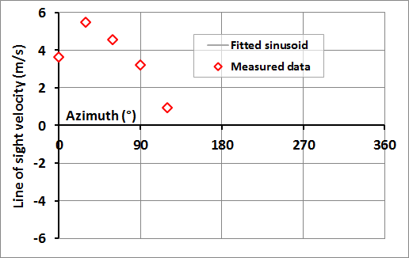
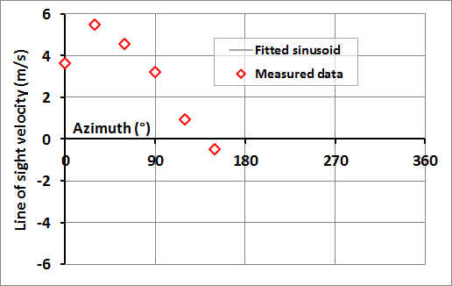
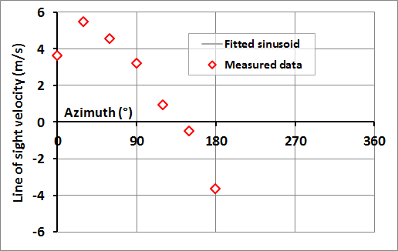
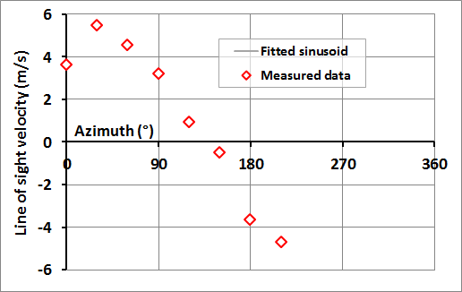
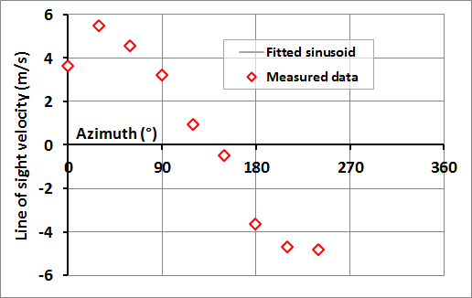
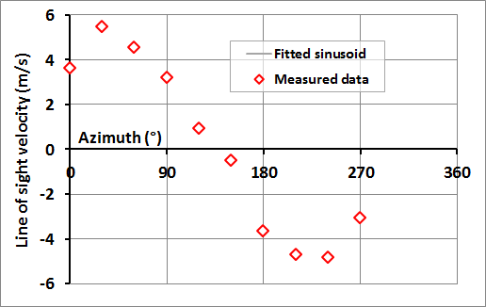
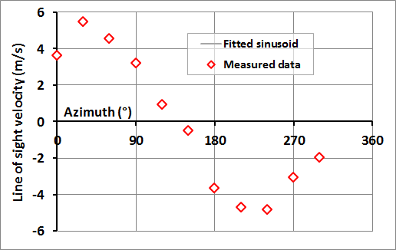
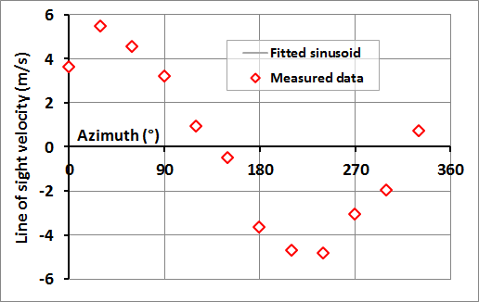
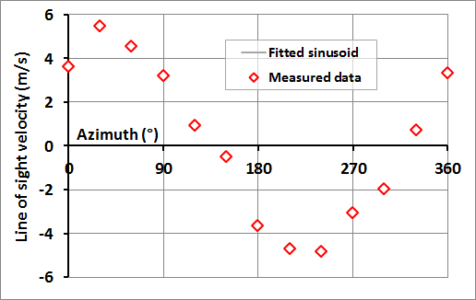
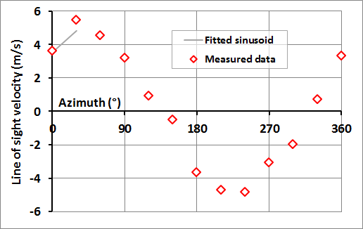


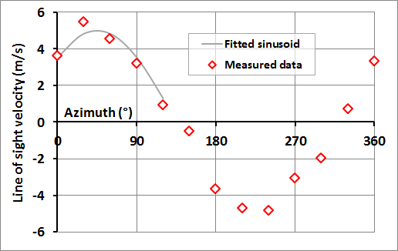

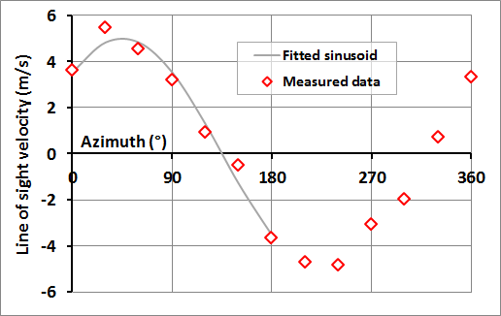

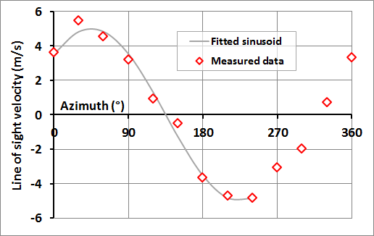

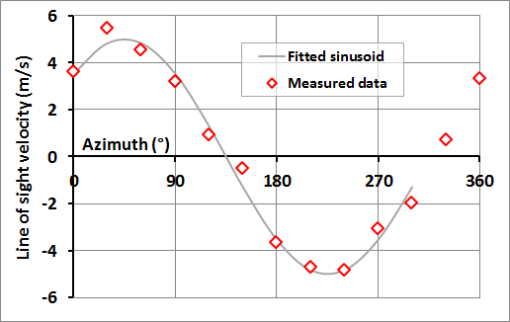


From Doppler shift to wind speed
VAD scans are derived from the observation of the variation of the radial velocity over an azimuthal range of 2π radians …
Wind direction
ø

Slide 9
From Doppler shift to wind speed
The parameters of the sinusoidal fit give the horizontal wind speed …

Slide 10
From Doppler shift to wind speed
… the vertical wind speed …

Slide 11
From Doppler shift to wind speed
… and the direction …
(N.B. sign for radial velocities: convention is negative => motion towards, positive => away, which introduces a 180° shift above)

Slide 12
Arc scans
You don’t need 2π of radians to fit a sinusoid. If the scan geometry traces an arc < 2π you are no longer restricted to scans in the volume of air above the device …

Slide 13
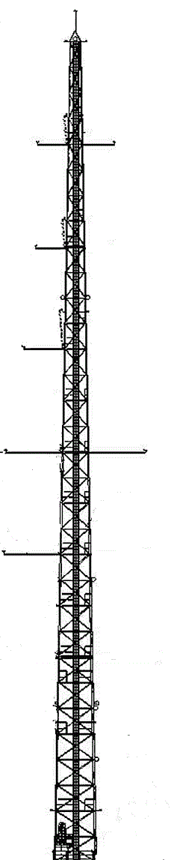
Arc scans
Wind parameters are mathematically derived from arc scans the same way they are from VAD scans …
VAD scan
VAD scan
Mast
Arc scan
Arc scans replicate VAD functionality.
(Related) PPIs survey areas with higher spatial resolution.
The term “arc” is preferred to the historical term “sector scan” since the Doppler values at the edge rather than enclosed within the area are used.
Lidar

Slide 14
IEA Use Cases
The IEA Wind Energy Task 32 is adopting a "use case" framework for describing the application of lidar in wind energy assessments to ensure well-documented measurement techniques applied in a manner that is fit-for-purpose with the degree of consistency required for investor confidence
A use case considers three things
Data requirements: articulated without reference to the capabilities of the possible methods that are available to fulfil them.
Measurement method: there are multiple options available whose suitability depends upon the data requirements that are being fulfilled.
Situation: the performance of a particular method may depend upon the circumstances in which it is deployed.

Slide 15
IEA Task 32 Lidar Use Cases
Data requirements
Measurement method
Data acquisition situation
Clifton, A. et al., IEA Wind Energy Task 32 Remote Sensing of Complex Flows by Doppler Wind Lidar: Issues and Preliminary Recommendations, NREL, 2015

Slide 16
IEA Task 32 Lidar Use Cases
What measurement accuracy is verified in this situation?
What data requirements arise in this situation?
What measurement method fulfils my data requirements?

Slide 17
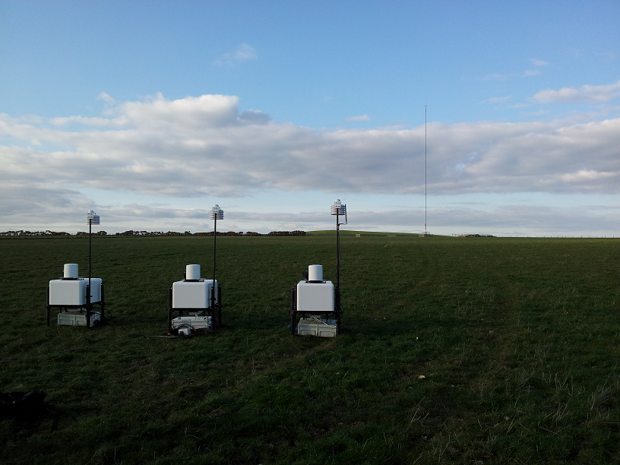
Calibration
Arc scans measurements can be compared to a standard IEC compliant met mast as one would with VAD scan measurements
50m
30m

Slide 18
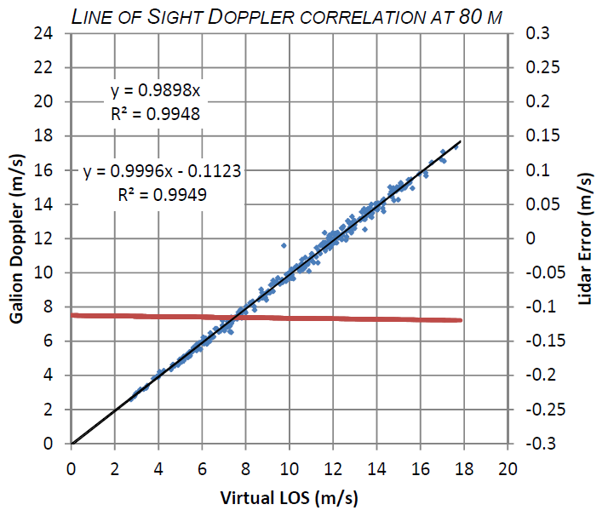
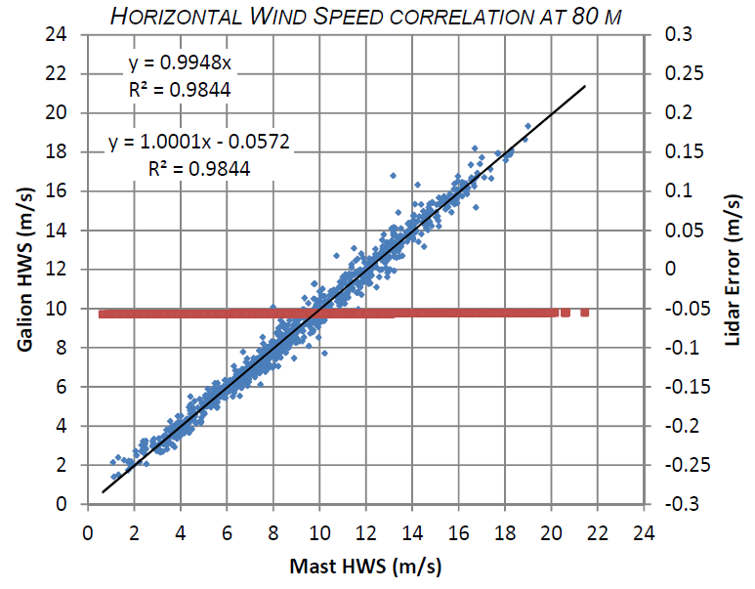
Calibration
We can verify the accuracy of the individual line of sight radial velocity measurements and the horizontal wind speeds extracted from them
Radial velocity and horizontal wind speed performance are not the same
Wind speed measurements can be influenced by effects to which radial velocity measurements are insensitive
Good radial velocity performance is not necessarily a reliable predictor of good wind speed performance, which must be verified separately

Slide 19
Compliance with IEC 61400-12-1 Annex L
Section L.1 (General) requires “only ground based remote sensing devices are used”
Section L.6 requires
"the extremes of the measurement volume at hub height H shall not lie closer to the test wind turbine than 2D, where D is the rotor diameter, and the centroid of the measurement volume shall not lie further than 4D from the test wind turbine"
“an inverted conical scan geometry is used for illustrative purposes only: this guidance is not limited to this particular scan geometry”
“Probe volumes within which the remote sensing device acquires a radial velocity measurement shall be free of wakes and flow perturbation from wind turbines and obstacles”
I.e. the location of the measurement volume and the probe volumes within it are constrained, not the location of the device itself (other than the general requirement for the adoption of “ground based” methods for power curve tests)
In general, to support the traceability and transferability of the calibration and verification of a device you should
Use the same (ground based) wind speed measurement method as is used during the application (power curve test)
Under circumstances as similar as possible

Slide 20


Slide 21
Performance verification
Site Acceptance Testing
Lidar Use Case (IEA Wind Task 32)
Data Requirements (applications and related acceptance criteria)
Measurement Situation (test site, reference instrument, lidar device)
Measurements method (e.g. remote mast scan / arc scan)
Performance Verification
Data synchronisation and filtering criteria for reference instrument and lidar (e.g. free stream, PiF, PiA, RMSE/HWS)
Data completion criteria and results after filtering
Verification method (for wind speed and direction, e.g. OLS, binned deviations)
Test Results (e.g. wind speed and direction correlations and binned deviations)
Comparison of results to acceptance criteria
Conclusions and recommendations

Slide 22
Performance verification
Site Acceptance Testing
Lidar Use Case (IEA Wind Task 32)
Data Requirements (applications and related acceptance criteria)
Measurement Situation (test site, reference instrument, lidar device)
Measurements method (e.g. remote mast scan / arc scan)
Performance Verification
Data synchronisation and filtering criteria for reference instrument and lidar (e.g. free stream, PiF, PiA, RMSE/HWS)
Data completion criteria and results after filtering
Verification method (for wind speed and direction, e.g. OLS, binned deviations)
Test Results (e.g. wind speed and direction correlations and binned deviations)
Comparison of results to acceptance criteria
Conclusions and recommendations
Acceptance criteria
Indicate fitness for purpose
Are application specific
Are among the data requirements of the use case
Arise in relation to achieving outcome-driven rather than constraint-driven objectives
I.e. “what do I want to measure” not “what can I measure”

Slide 23
Typical acceptance criteria
Data completion (IEC 61400-12-1 2nd edition (FDIS))
≥3 pairs in each wind speed bin between 4 and 16 m/s inclusive
≥180 hours overall
Horizontal wind speed comparison with reference
Linear OLS regression slope between 0.98 and 1.02
Linear OLS regression offset (m/s) between -0.2 and 0.2
Linear OLS coefficient of determination ≥0.98
Binned percentage wind speed error within reference uncertainties between 4 and 16 m/s
Wind direction comparison with reference
Linear OLS regression slope between 0.98 and 1.02
Linear OLS regression offset (°) between -5 and 5
Linear OLS coefficient of determination ≥0.98
Average wind direction error in each sector (°) <5
Average standard deviation of error in each sector (°) <10

Slide 24
3rd party review: Fraunhofer IWES
Scanning lidar’s arc scan capability allows measurements “where a horizontal distance between the location of the measurement device and its measurements is necessary.”
(Fraunhofer IWES, 2013)
“[Scanning lidar] may be recommended ... for a power performance assessment offshore with the [scanning lidar] installed on the transition piece of the test turbine.”
(Fraunhofer IWES 2013)
Notes:
These quoted extracts from the Fraunhofer validation study speak for themselves, this paper and other independent validations can be found online at www.sgurrenergy.com

Slide 25
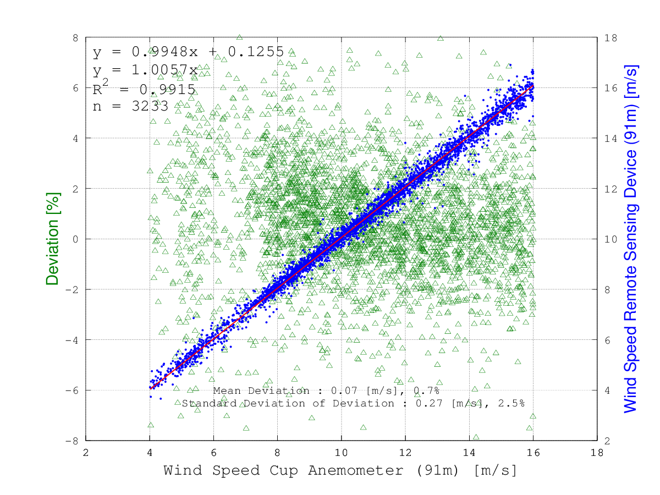
In situ calibration

Slide 26
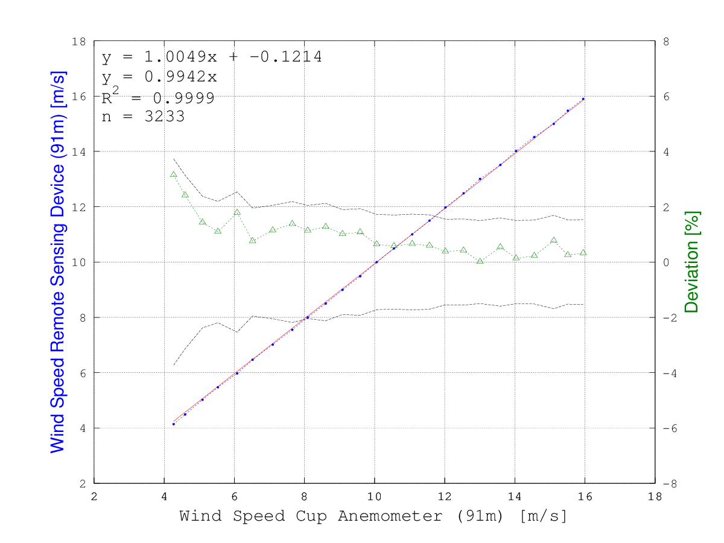
In situ calibration

Slide 27
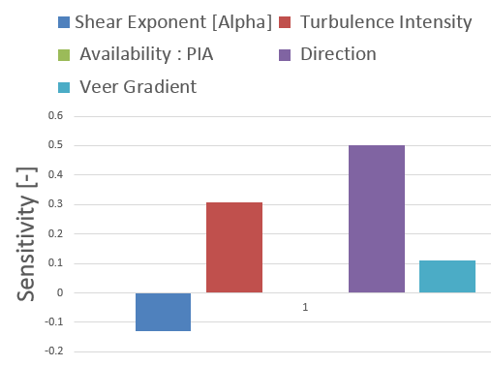
In situ classification

Slide 28
In situ classification
Relatively low sensitivity to shear is observed
The technique is effectively a VAD with a reduced sensitivity to shear due to a lower elevation angle
N.B. you should always be assessing shear sensitivity anyway as a check for measurement height error¹
Relatively high sensitivity to turbulence considered due to relatively narrow arc size (which on this occasion was 30° to minimise the measurement volume as the reference was approximately 1 km away)
Turbulent decorrelation can occur for narrower arcs if the variation in radial velocity due to turbulence exceeds the variation due to scanning
In practice arc sizes can range from 30° to 360° based on project specific considerations (N.B. 360° is not a VAD if the upwind arc is selected to represent inflow for any given wind direction)
Direction sensitivity dominates
This is likely to be due to reference met mast flow distortion effects
In general we find reference uncertainty dominates results
We need a new approach to calibration and classification (e.g. inter-comparisons with and between multiple references)
¹Consider Lindelöw method and using shear comparison to confirm pulse timing

Slide 29
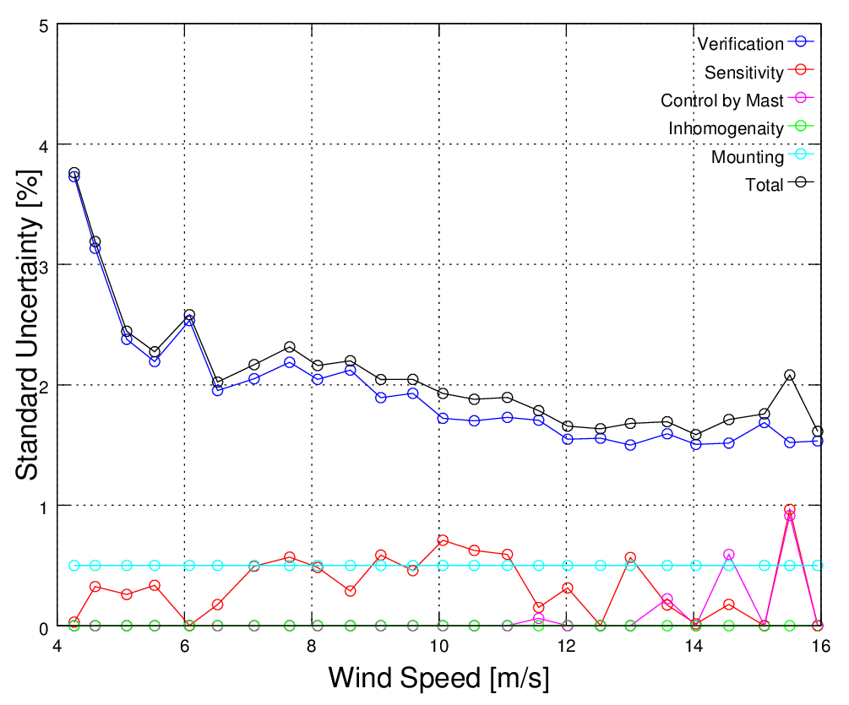
Wind Speed Uncertainty Results

Slide 30


Slide 31
3rd party review: Deutsche Windguard
DWG “considers the application of arc scanning lidars mounted on the transition piece of offshore wind turbines for the purpose of wind turbine power curve testing as an attractive alternative to other possibilities of testing power curves of offshore wind turbines”
“The T-piece method is almost fully consistent to the draft revision of the power curve testing standard [...] The only non-compliance [...] is that no monitoring met mast is applied”
“DWG does not see that as a relevant burden for an application of the T-piece method, as there are different other appropriate procedures available”
“Overall, DWG has high hopes for the T-piece method and is looking forward to perform power curve tests with this procedure”

Slide 32
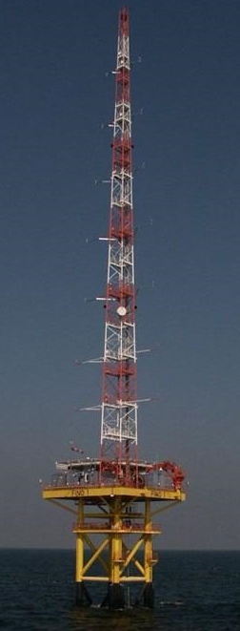
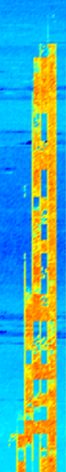
Pointing accuracy
Reflective optics allows verification of accuracy during Factory Acceptance Testing (FAT) by injection of a visible laser signal (not possible with refractive optics)
Hard Target Returns (HTR) can be used during Site Acceptance Testing (SAT) and application
Use independent encoder signals rather than scan motor control signals for angle information
(The pointing accuracy of the Galion is shown by observing the hard target returns from a raster scan of the FINO1 mast nearly 1km away from the transition piece of AV7 where the Galion is installed)

Slide 33

Track record to date
Onshore arc scan SATs in Scotland (34 across 4 different sites, none of which satisfy Annex B), Germany (6 at DWG site, satisfies Annex B), North America (8 different sites, some of which satisfy Annex B)
Offshore arc scan SAT at Alpha Ventus (satisfies Annex B)
Onshore PCTs in USA, Canada, Norway, Germany, Scotland, Ireland (including simple and complex terrain)
Offshore PCTs at Alpha Ventus, Sheringham Shoal (x 2), Greater Gabbard, Confidential projects (x 2)

Slide 34
Track record to date
Over 50 arc scan SATs (calibrations and verifications)
Over 10 PCTs (with and without accompanying met masts)
Number of SATs > number of PCTs because arc scans are widely used for other objectives
Noise impact assessments (NIAs)
CFD model validations
Wind resource assessment
Onshore-to-offshore measurements
Complex shear assessments
Project optimisation and forestry assessments
Yaw error detection and correction
Arc scan SATs are often used to support use of scanning devices in other configurations, e.g. PPIs, RHIs
Other measurement methods that replicate met mast functionality are amenable to SAT, e.g. VAD, DBS, convergent scan geometries
Arc scans can be used to enable in situ verification of nacelle mounted lidar measurement methods
Typical scanning lidar devices used have ranges that ensure measurements can be acquired outside the compression zone

Slide 35
Conclusions
If you would accept a VAD for a PCT you should be able to accept an arc scan subject to the same requirements with respect to SAT
Arc scans replicate VAD capabilities where you can't (easily or economically) do VADs (it’s “a VAD for when you can’t do a VAD”)
Confidence in arc scans should be supported by confidence in the well-established ground based methods it is derived from
Arc scans can be combined with other scan geometry elements in sophisticated campaigns to achieve multiple objectives
Arc scans allow wind shear measurements suitable for REWS and complex shear assessments
A device can be configured to acquire data for testing multiple WTGs
T-piece mounting provides the highest degree of IEC compliance offshore in absence of a met mast
Pointing accuracy and shear sensitivity do not impact category B uncertainty
Consistency between calibration and application should lower category B uncertainty relative to other methods where consistency is not demonstrated

Slide 36
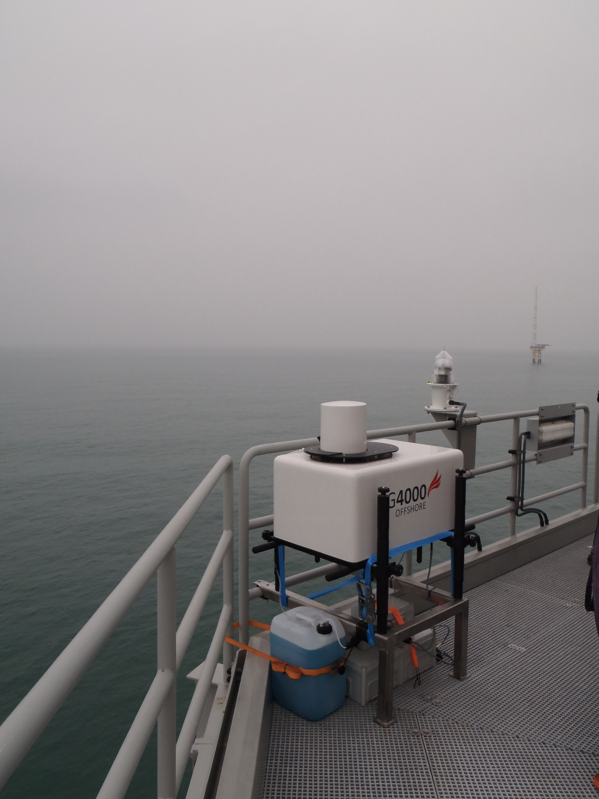
Thank you for listening
Email: peter.clive@sgurrenergy.com
Tel: +44 (0) 141 227 1724
Cell: +44 (0) 7739 909 040
Web: http://www.sgurrenergy.com

